Slide 1

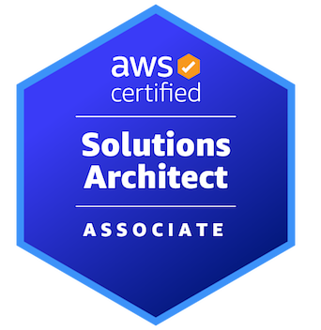

AWS CERTIFIED SOLUTIONS ARCHITECT - ASSOCIATE
Automation and Governance
AMBER ISRAELSEN
Developer | Technical Trainer
Notes:
m13-01 = “Module Introduction”
Welcome back, everyone, and thanks for sticking with me! This, of course, is AWS Certified Solutions Architect Associate and I’m your guide, Amber Israelsen.

Slide 2
Course Outline (Part 2)
Monitoring
Security and Compliance
Automation and Governance
DNS and Network Routing
Application Integration
Machine Learning
Backup and Recovery
Billing and Pricing
The Well-Architected Framework
Preparing for the Exam
Notes:
We continue to make good progress, having covered security and compliance in the last module. In this module, we’re going to move on to talk about automation and governance. Which I know can be broad and vague terms sometimes. But this will include services like CloudFormation—or infrastructure as code—Service Catalog, Systems Manager and other services that take some of the manual work and guesswork out of setting up and maintaining your infrastructure.
Let’s get started.

Slide 3





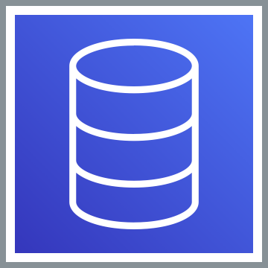

CloudFormation: Infrastructure as Code
HTTP
EC2 Instance
Databases
Application Load Balancer
EC2 Instance
Notes:
m13-02 = “CloudFormation Overview” – re-use m4-72
Now let’s move on to talk about CloudFormation. This is AWS’s “infrastructure as code” solution. This is a really powerful service in AWS, and it’s core to everything else.
You might have a fairly small or simple project—but even so, let’s say you need an (click) EC2 instance, and another (click) EC2 instance, you want an (click) auto-scaling group and then you also (click) need a load balancer, you need (click) a database or two just to build a simple website for your users.
You can imagine that having to go spin up all of those resources manually could be tedious and time-consuming, and you might not remember all the details of how you did it, so you might get a slightly different setup each time you did it. AND this isn’t even a large or complicated project—you can imagine some companies have hundreds or thousands of infrastructure resources they need to spin up, and dozens or hundreds of people doing that work at any given time.

Slide 4
I WANT:
2 EC2 instances with this configuration
An auto-scaling group and load balancer
1 RDS database
1 VPC with 1 public subnet and 1 private subnet
Notes:
Wouldn’t it be easier to say, I want—and then define the resources and configuration for them--
2 EC2 instances with this configuration
An auto-scaling group and load balancer
1 RDS database
1 VPC with 1 public subnet and 1 private subnet
And then those things are automatically built.

Slide 5
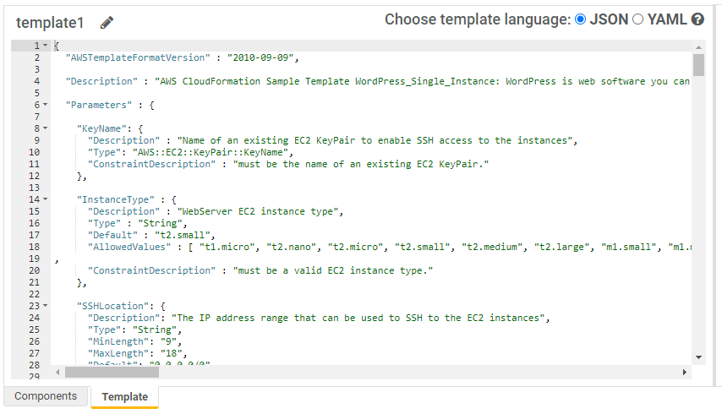
CloudFormation Template
Notes:
Well, that’s basically what you get with CloudFormation. Here’s an example of a CloudFormation template where you define the resources you want in a JSON or YAML document and then deploy it. This, of course, spins up all those resources—whether it’s VPC, databases, EC2 instances, load balancers or any other kind of resource.

Slide 6
Benefits of CloudFormation
Huge time savings over manual work
Repeatable
Changes are also made as code
Can delete all resources at once
Estimate costs based on a template
Can be used cross-account and cross-region
Notes:
So the benefits of this are huge:
It should be obvious, but CloudFormation offers a huge time savings over doing the work manually
It’s repeatable. You run a template in a dev environment, let’s say, and then you can run it in a test environment and know that you’re getting exactly the same infrastructure and resources with exactly the same configuration.
Any changes you make are also done in code, so it’s easy to track what changed. You can even check the templates into source control, just like you would any other code, so you can see the changes that way too.
Also, you can tear down all the resources at once too with the click on a button.
You can get more accurate estimates of what things will cost simply by using the CloudFormation template. So this is pretty huge.
And finally, you can use CloudFormation to deploy across AWS accounts and across regions, which is an important point that might come up on the exam.

Slide 7
DEMO
Deploying a CloudFormation Template
Notes:
m13-03 = “Deploying a CloudFormation Template” – re-use m4-73, but update badge
In this demo, we’ll be using one of the sample templates provided by AWS and then deploy it. We’ll also take a look at the template itself and revisit some of the things we saw in the slides.
In the CloudFormation console
Create stack
You’ve got three options here: template is ready, use a sample or create your own in the Designer. In the real world, you’ll probably have one already, but I want to make sure you can follow along with the demo so we’re going to use one of the samples that AWS provides. Use a sample template.
Simple (not multi-AZ) LAMP Stack (Linux, Apache, MySQL, and PHP), which will deploy a single EC2 instance and a MySQL database.
View in Designer
And this designer gives you a nice visual of what you’re creating (might need to put zoom level all the way to the top + sign) , as well as the code down below that’s defining that deployment. You can make modifications on the graphical part of the designer, but I tend to just use the code.
So here you’ll see things like database name, database user, scrolling down, you’ll see the Resources section, with an EC2 instance, an index.php page we’re going to create when we launch the instance, and we’ll be able to navigate to that web page. We’ve also got a security group down here at the bottom.
But let’s back up (click Close link at top), close out of the designer, and go ahead and deploy this.
Parameters:
Stack name: my-lamp-stack
DBPassword: password
DBRootPassword: password
DBUser: admin
KeyName: MyKeyPair
Next, Next, Create Stack
Watch progress (creating security group, creating instance…)
Done – show Resources tab and Outputs (also show if you go to EC2 console and instances, it’s there)
Go to WebsiteURL and show it’s live
So that’s how to create a new stack, which is pretty straightforward. Now let’s see how easy it is to delete all those resources as well.
So in our EC2 list of instances, we have one there.
Delete stack
Show events, that it’s in progress
When it’s done, show that the instance is gone
So that’s it—that’s how to create infrastructure using code.

Slide 8


SERVICE CATALOG
Notes:
m13-04 = “AWS Service Catalog Overview”- re-use m4-74
I’m not sure how many of us look through actual paper catalogs anymore these days, but just humor me for a minute and pretend you do. You flip through the catalog—oh, I want that gadget and that widget and that whatever-it-is. It’s a place to pick things you want.
Well, in AWS, that’s exactly what Service Catalog is too.

Slide 9



SERVICE CATALOG
Web Development Portfolio
Data Analysis Portfolio
EC2
S3
Portfolios made up of products
Application Load Balancer
Athena
Database
QuickSight
Notes:
Service catalog is made up of portfolios. So (click) maybe you have a portfolio for web development and one for data analysis.
(click) And then within a portfolio, you have products. Maybe web development (click) has products for EC2, application load balancer (click) and a database. And data analysis would include (click) S3, Athena and QuickSight. So a product is essentially an AWS service.

Slide 10
AWS Service Catalog
IT-approved resources that teams can provision
Engineering teams can provision things from the catalog
Notes:
The motivation behind this is that a company might want to limit the AWS resources that can be used. There are 200+ services in AWS now, and companies want some sort of governance and consistency in what and how their teams are doing development. So the IT department says, okay, we only want to use these, let’s say, 20 services, and they put those in various portfolios. So it gives them some guardrails for how they’re using AWS.
And then the engineering teams that are doing the work, they can go into the catalog and say, okay, I’m building a website, let’s say, and provision the different approved products that are part of that portfolio and know that it’s okay to use them.
So for the exam, if you get a question about centrally managing what services are available, then think Service Catalog.

Slide 11


I need to patch all my servers
On-Premises
Notes:
m13-05 = “AWS Systems Manager and Parameter Store Overview”
All right. We’ve seen how to create various AWS resources, and at some point, you’ll probably end up with quite the fleet of servers—EC2 instances if you’re using AWS, and physical servers if you’re also running things on-premises. You can imagine there could be dozens, hundreds or thousands of servers.
And at some point (click), you’re probably going to need to patch all of those servers or run some other command, maybe update drivers or install a piece of software on all your machines. If you have to log into each of those servers manually and do the updates, that would be very tedious and time-consuming.

Slide 12

AWS Systems Manager (SSM)
Manage your fleet of servers at scale
EC2 instances and on-premises servers
Supports Linux and Windows
Common use cases
Patching and maintenance
“Run Command” to install applications, capture log files, perform configuration changes
Parameter Store to manage global configuration settings
Notes:
That’s where AWS Systems Manager or SSM comes in. This service is used to manage your fleet of servers at scale, which includes your EC2 instances in AWS, and also on-premises servers if you have them.
There’s support for both Linux and Windows machines.
Common use cases for this include patching and maintenance
There’s also a “Run Command” in SSM that’s used for things like installing applications, capturing log files, updating configuration and so on across all your systems
And finally, there’s a feature called Parameter Store where you can manage global configuration settings—things like database strings, Amazon Machine Image IDs, passwords and so on.
So it’s very comprehensive and kind of an advanced topic. For the exam, though, if you get questions about how to manage or patch a large number of systems at scale, including those on-premises, then AWS Systems Manager is probably what you want.
Now let’s talk in a little more detail about this final bullet, the Parameter Store.

Slide 13


The Need for SSM Parameter Store
Database strings
Amazon Machine Image (AMI) IDs
License codes
Passwords
Application or
CloudFormation Template
Configuration and Secrets Information
Notes:
The motivation for Parameter Store is something like this...
(click) You have an application, or even just a CloudFormation template that’s used to build some infrastructure, and it needs (click) access to things like database strings or the ID of an Amazon Machine Image or AMI, maybe license codes or passwords, user names, that kind of thing. Configuration and secrets information.
By now, you should hopefully know that you shouldn’t be hard-coding that stuff into your code. Instead, you’d store it in Parameter Store and then retrieve it using your application’s code or from a CloudFormation template.

Slide 14
SSM Parameter Store vs. Secrets Manager
SSM PARAMETER STORE
SECRETS MANAGER
Can store encrypted AND unencrypted data (uses KMS for encryption)
Uses IAM to control access to secrets
Integrates with CloudFormation
No additional cost, up to 10,000 parameters
Does not support secrets rotation
Can ONLY store encrypted data (uses KMS for encryption)
Uses IAM to control access to secrets
Integrates with CloudFormation
$0.40 per stored secret and $0.05 for 10,000 API calls
Can automatically rotate secrets
Can generate random secrets
Notes:
And you might be thinking, well, that sounds an awful lot like Secrets Manager that we covered in the Security module. And you are correct! They’re very similar. But there are a couple key differences, and you might have questions on the exam that test whether you know the differences, so let’s go over that.
For Parameter Store:
Can store encrypted AND unencrypted data (uses KMS for encryption)
Uses IAM to control access to secrets
Integrates with CloudFormation
No additional cost, up to 10,000 parameters
Does not support secrets rotation
And then on the other side, for Secrets Manager…
Can ONLY store encrypted data (uses KMS for encryption)
Uses IAM to control access to secrets
Integrates with CloudFormation
$0.40 per stored secret and $0.05 for 10,000 API calls
Can automatically rotate secrets
Can generate random secrets
So similar, but with a couple key differences. If you get a question on the exam that mentions you need to rotate secrets, then think of Secrets Manager. Or if there’s a question about storing unencrypted or plain text data, then Parameter Store is the only option there.
https://acloudguru.com/blog/engineering/an-inside-look-at-aws-secrets-manager-vs-parameter-store

Slide 15
Important Points to Remember
CLOUDFORMATION
“Infrastructure as Code,” defined in a JSON or YAML template
Repeatable way to deploy, update and delete resources
Can be used cross-account and cross-region
SERVICE CATALOG
An approved “catalog” of products that developers can use
Organized into portfolios (e.g., web development, data analysis)
SYSTEMS MANAGER (SSM)
Manage a fleet of servers at scale
Commonly used for patching and maintenance
Parameter Store is used to store configuration information and secrets (unencrypted AND encrypted)
If you need to rotate secrets, you should use Secrets Manager instead
Notes:
m13-06 = “Important Points to Remember”
CLOUDFORMATION
“Infrastructure as Code,” defined in a JSON or YAML template
Repeatable way to deploy, update and delete resources
Can be used cross-account and cross-region
SERVICE CATALOG
An approved “catalog” of products that developers can use
Organized into portfolios (e.g., web development, data analysis)
SYSTEMS MANAGER (SSM)
Manage a fleet of servers at scale
Commonly used for patching and maintenance
Parameter Store is used to store configuration information and secrets (unencrypted AND encrypted)
If you need to rotate secrets, you should use Secrets Manager instead

